Slide 1
Preliminary CoVID19 Data analysis Aug 06, 2020 YuMei Bennett
Data Source Selection
Data Preparation
Early Data Analysis
Univariant Forecast
Multivariant Forecast

Slide 2
Data Source
Data was taken from the COVID Tracking Project, https://covidtracking.com/
The public COVID tracking project by volunteers.
The compile is taken directly from the websites of state/territory public health authorities.
Same data was chosen by JHU.
Data is up to July 15, 2020
Our goal is to provide preliminary analysis on Illinois and US COVID status and forecast
Compares the State of Illinois with National US.

Slide 3
Data Preparation
Dataset was recorded on daily basis, most recent first.
Dataset goes back to late Feb, but the early days, test was only done for sick people. Given what we know about long covid19 incubation period, a subset of the data is presented here.
Forecast models are built with after May 3rd data, when majority of the state start to broaden the COVID test coverage.
Explored both daily test positive & death count, and daily positive & death rate.

Slide 4
Please keep in mind
The model can only be as accurate as the dataset itself. Many other significant impact factors didn’t record in dataset, like rules for social distancing, public gathering etc.
Data tracking project pulls data from various government agencies public database, for which is rely on local hospital and health agencies to input and update on daily basis.
Procedures to input the data varies by local governance policy.
Methodology to record each data field criteria may be different state by state,
COVID testing are only done on volunteers or as part of job requirement.
For the purpose of building statistical model, the data sample should represent a set of randomly selected subject among the interested population.
Data collected isn’t 100% meeting the random subject sampling criteria.
We are here to empower you the state authority with what we see from statistical analytics view, such that you can make an informed decision!!

Slide 5
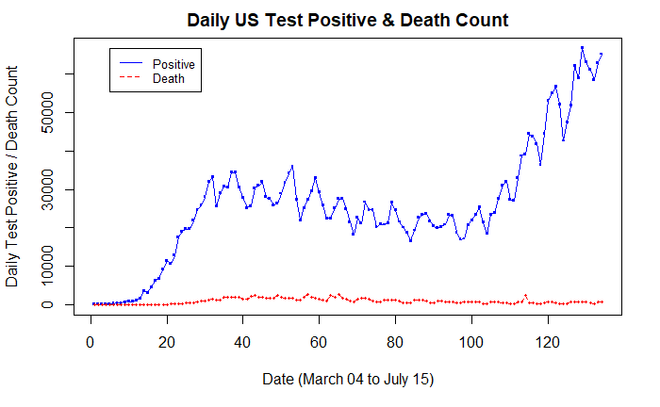
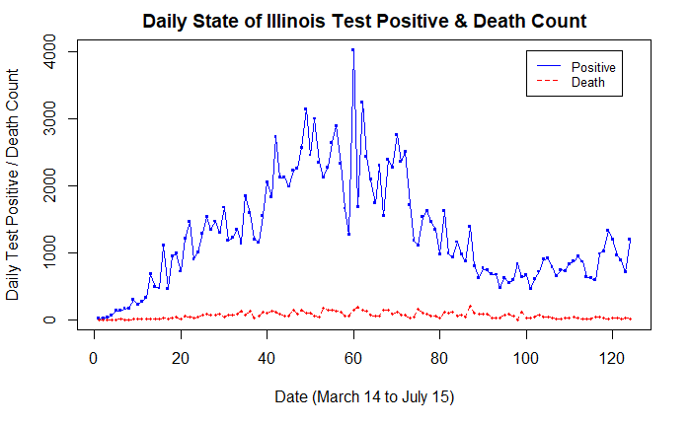
Early Data analysis – Daily Count Plot
US daily test positive count is still on the rise.
Illinois daily test positive count is stabilizing.

Slide 6
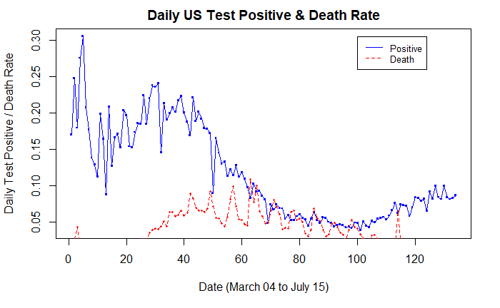
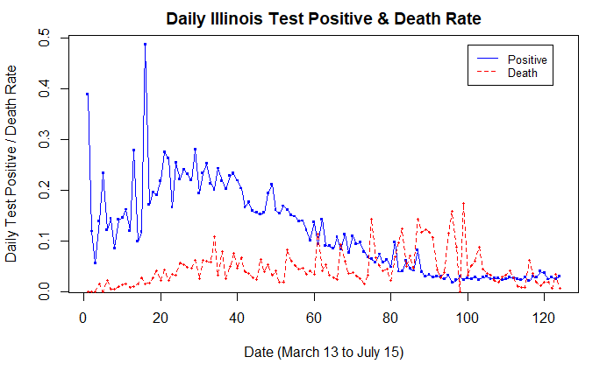
Early Data analysis – Daily Rate PLOT
US daily test positive rate lowered to ~5% at end of June, then climbed back up to ~10%.
Illinois daily test positive rate lowered to ~5% since mid of June, and keeping steady.

Slide 7
Data Preparation – why focus on test positive rate
Percent positivity can also help us determine if an increase in cases is simply the result of expanded testing or if it signals increased transmission of the virus.
If a rise in cases count is the result of increased testing, the percent positive line could look flat or like it is decreasing over the time period when cases increased.
If a rise in cases count is the result of increased transmission, the line could appear to be increasing over that same time period.
On May 12, 2020 the World Health Organization (WHO) advised governments that before reopening, rates of positivity in testing (ie, out of all tests conducted, how many came back positive for COVID-19) of should remain at 5% or lower for at least 14 days.

Slide 8
Early Data analysis – Dataset fields
Data Set Columns |  | Considered |  |  |  | Considered
Date |  |  |  | Death | Cumulative
States |  |  |  | Hospitalized | Cumulative
Positive | Cumulative |  |  | lastModified | Same as dataChecked
Negative | Cumulative |  |  | Total | Cumulative
Pending |  |  |  | totalTestResults | Cumulative
hospitalizedCurrently |  | YES |  | posNeg | Cumulative
hospitalizedCumulative |  |  |  | deathIncrease |  | YES
inIncuCurrently |  | YES |  | hospitalizedIncrease |  | YES
inIcuCumulative |  |  |  | negativeIncrease |  | YES
onVentilatorCurrently |  | YES |  | positiveIncrease |  | YES
onVentilatorCumulative |  |  |  | totalTestResultIncrease |  | YES
Recovered | Cumulative |  |  | hash
dateChecked | entry date

Slide 9
Early Data analysis – test positive rate
Focus of the analysis:
Posrate = positiveIncrease / totalTestResultIncrease

Slide 10
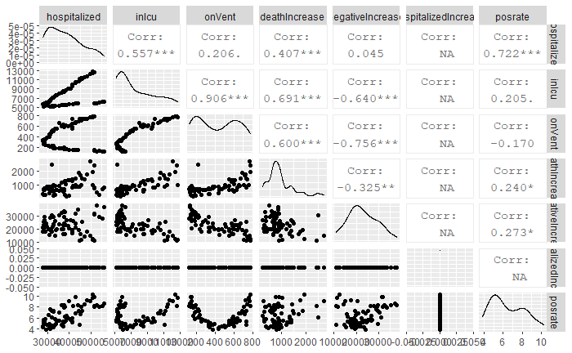
Early Data analysis – US Test positive rate correlation

Slide 11
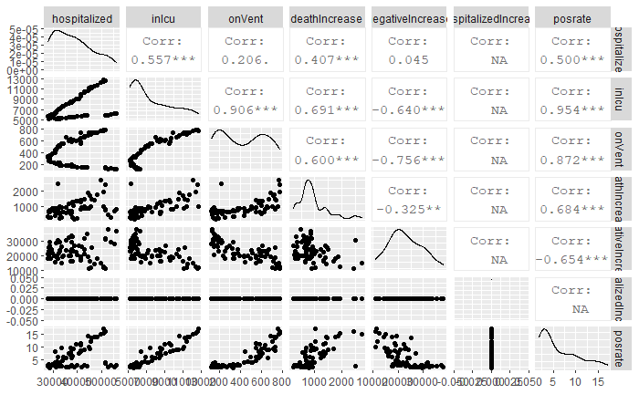
Early Data analysis – IL Test positive rate correlation

Slide 12
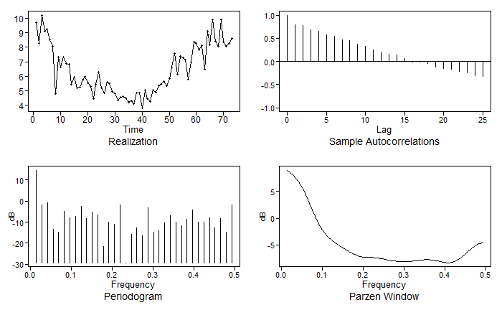
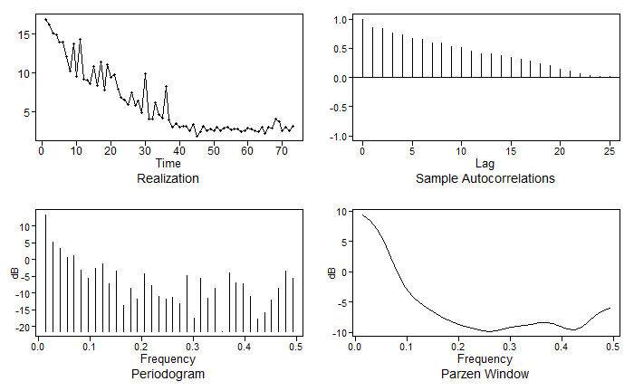
Early Data analysis – ACF and Frequency Density
US Daily Test Positive Rate – May 3rd to July 15
IL Daily Test Positive Rate – May 3rd to July 15
Both Datasets appear to be stationary. Significant high frequency near 0, with low peak at 0.5.

Slide 13
Uni Variants Analysis
ARMA, ARIMA, MLP and Ensemble

Slide 14
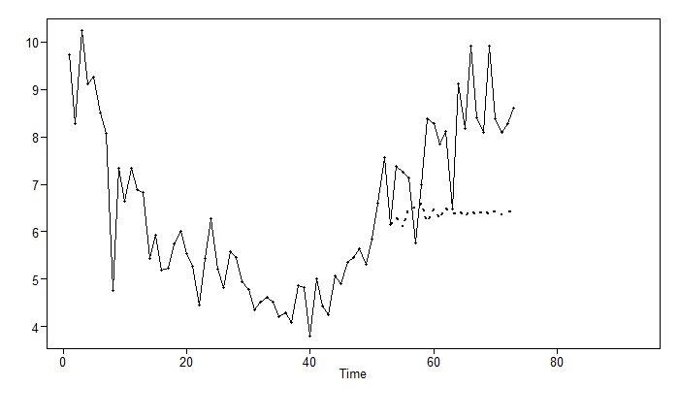
Univariant Models – US ARMA(7,2)
Windowed ASE = 5.927061
On last 20 actual compare to model forecast
ASE 3.689831
pval = 0.1018566
The 20 point lastn forecast doesn’t look good, but ASE is ok.
Windowed ASE is higher compare to last 20 forecast ASE.

Slide 15
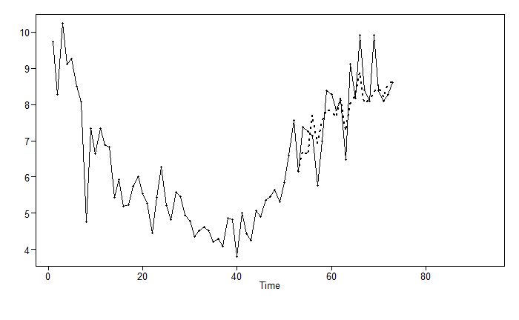
Univariant models – US ARIMA(14,1,2)
Windowed ASE = 0.7162283
On last 20 actual compare to model forecast
ASE 0.4512103
pval = 0.01950805
Although this model did not pass Box Ljung test for last 20 forecast residual, we felt the model does best represent the short term forecast need.

Slide 16
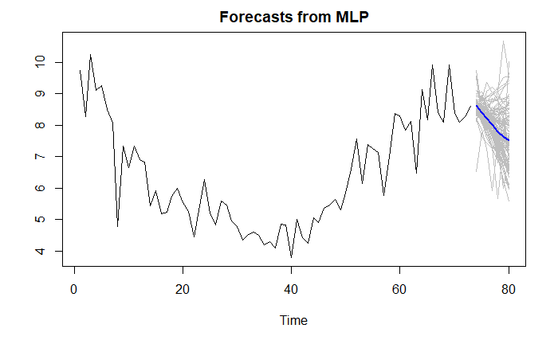
Univariant models – US MLP
Windowed ASE 1.765061
Graph shows 7 day forecast medium for 100 repetitions.
8.61, 8.39, 8.21, 8.03, 7.79, 7.65, 7.51

Slide 17
Univariant Models – US ensemble
Explored varies ARMA, ARIMA and MLP models
Tested model AIC and ASE
For long term, choose ensemble of ARMA(7,2), ARIMA(14,1,2) and MLP Univariant model
ARMA(7.2)
Rolling ASE 5.927061
ARIMA(14,1,2)
Rolling ASE 0.7162283
MLP Univariant
Rolling ASE 1.765061

Slide 18
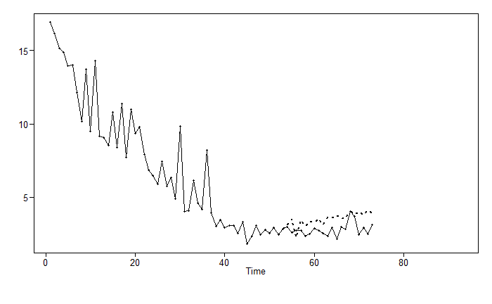
Univariant models – IL ARMA(12,3)
Windowed ASE = 0.3608145
On last 20 actual compare to model forecast
ASE 0.7890908
Box-Ljung test pval 0.108

Slide 19
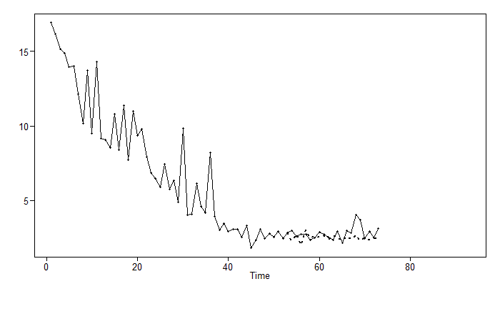
Univariant models – IL ARIMA(10,2,0)
Windowed ASE = 0.3371341
On last 20 actual compare to model forecast
ASE 0.3281278
Box-Ljung test Pval=0.0004020852

Slide 20
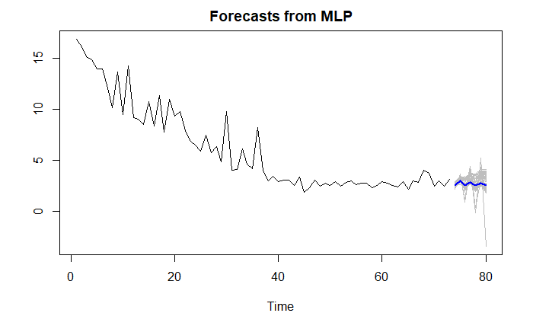
Univariant Models – IL MLP
Windowed ASE = 0.2934345
Graph shows 7 day forecast medium for 100 repetitions.

Slide 21
Univariant models – IL ensemble
Explored varies ARMA, ARIMA and MLP models
Tested model AIC and ASE
For short and long term, choose ensemble of ARMA(12,3), ARIMA(10,2,0) and MLP Univariant model
ARMA(12, 3)
Rolling ASE 0.36
ARIMA(10,2,0)
Rolling ASE 0.337
MLP Univariant
Rolling ASE 0.29

Slide 22
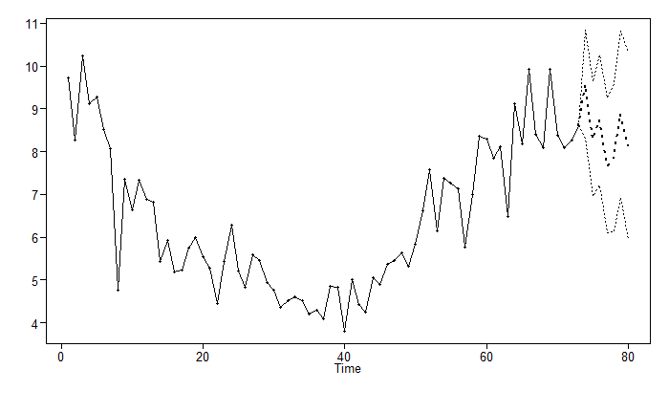
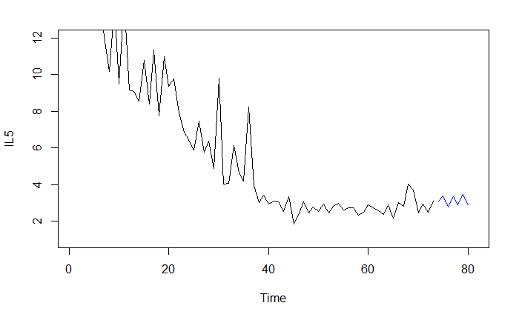
Univariant Forecast – SHORT term 7 Days
US Daily Test Positive 7 days Forecast
IL Daily Test Positive 7 days Forecast
ARIMA(14,1,2)
9.58, 8.29, 8.73, 7.67, 7.86, 8.87, 8.14
Ensemble
3.09, 3.37, 2.77, 3.34, 2.87, 3.44, 2.88

Slide 23
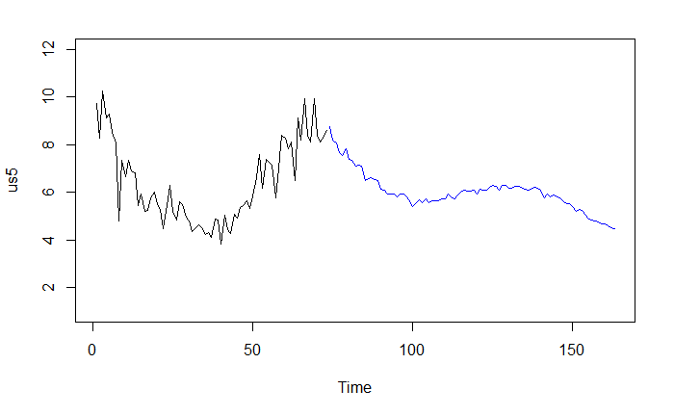
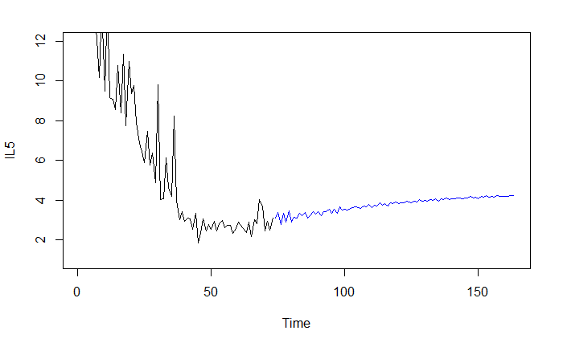
Univariant Forecast – Long Term 3 Month
US Daily Test Positive 90 days Forecast
IL Daily Test Positive 90 days Forecast
Ensemble of ARMA(7,2), ARIMA(14,1,2) and MLP Univariant model.
Ensemble of ARMA(12,3), ARIMA(10,2,0) and MLP Univariant model.

Slide 24
Multi Variants Analysis
VAR, MLP and Ensemble

Slide 25
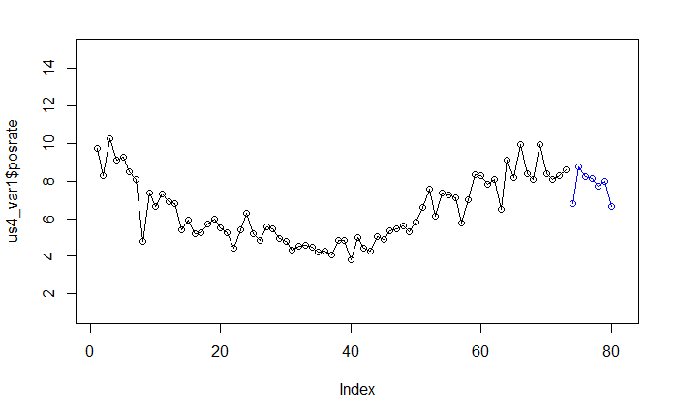
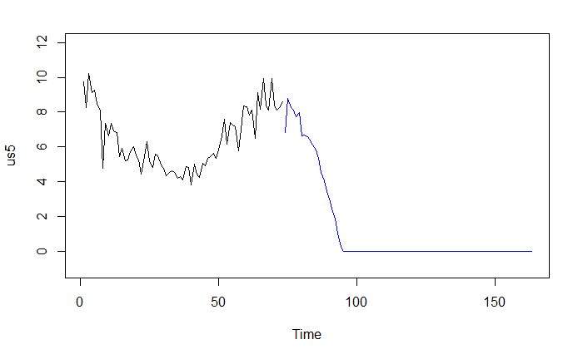
Multi variant models – US VAR
Windowed ASE = 12.9346
hospitalizedCurrently is co-factor for VAR model building.
Short term forecast looks reasonable
Long term forecast contains many negative values.
Set negative rate to zero for visualization.

Slide 26
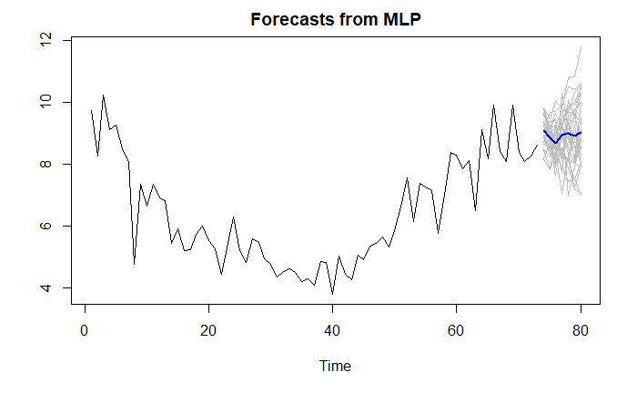
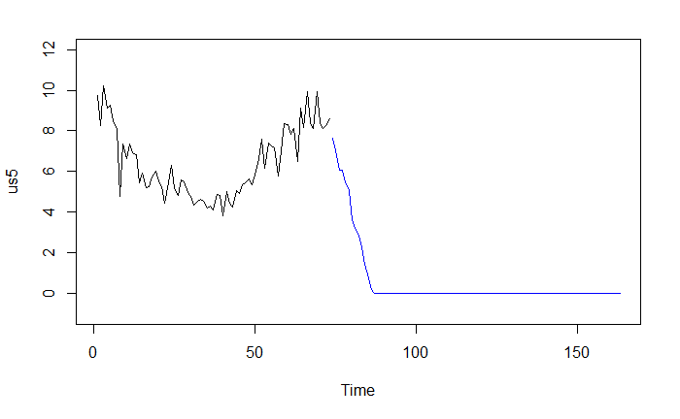
Multi variant models – US MLP
Windowed ASE = 1.949447
Use hospitalizedCurrently as part of MLP regressor model building.
Short term forecast looks reasonable
Long term show after ~25 days, positive rate drop down to below zero.
Likely test positive rate will stay close to zero.
Set all negative rate to zero for visualization.

Slide 27
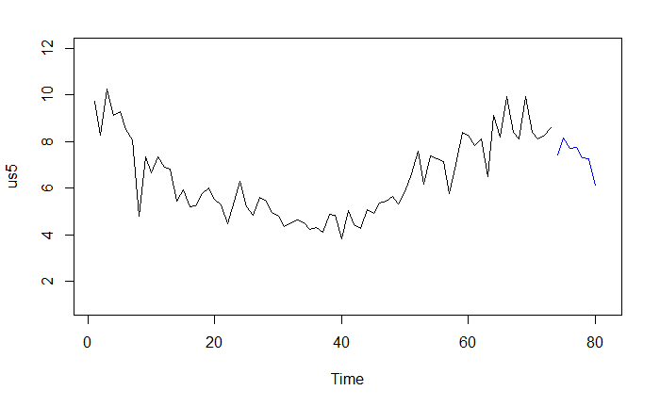
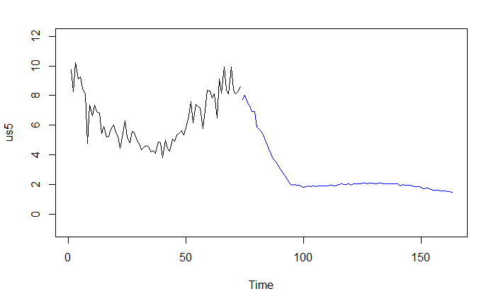
Multi variant models – US ensemble
Short Term Forecast Ensemble model is the average of VAR and MLP forecast.
For Long term Ensemble model, we take the average of VAR, MLP and univariant long term Ensemble forecast.

Slide 28
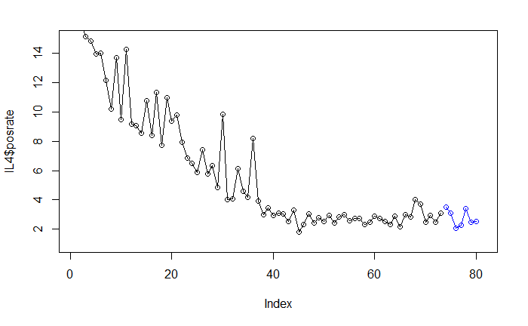
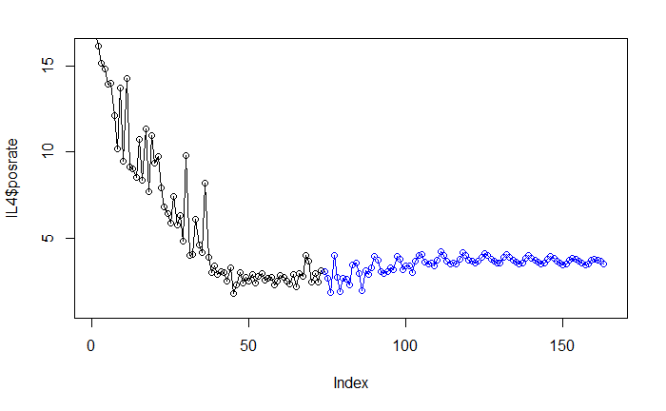
Multi variant models – IL VAR
Windowed ASE 10.66417
Variant selected:
hospitalizedCurrently,
deathIncrease,
inIcuCurrently,
onVentilatorCurrently and
negativeIncrease
These variables has a >0.5 correlation with positive rate.

Slide 29
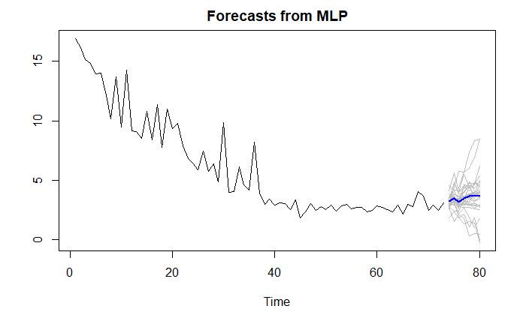
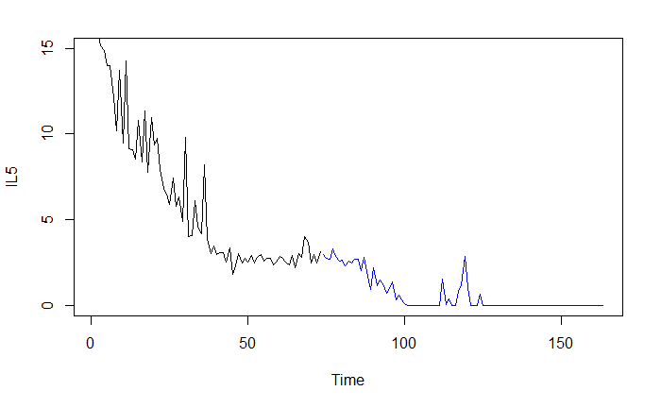
Multi variant models – IL MLP
Windowed ASE 0.978842
Regressors:
hospitalizedCurrently,
deathIncrease,
inIcuCurrently,
onVentilatorCurrently
Long term forecast has some negative values, we normalized to 0.

Slide 30

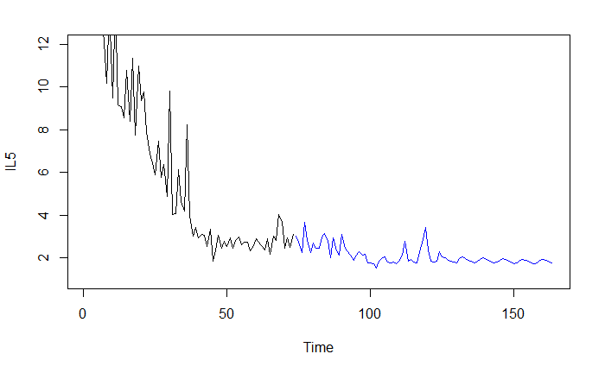
Multi variant models – IL ensemble
Ensemble model is the average of VAR and MLP forecast.
Both short term, and long term forecast looks reasonable.

Slide 31
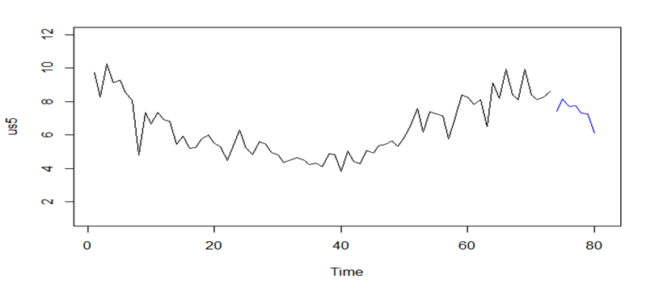
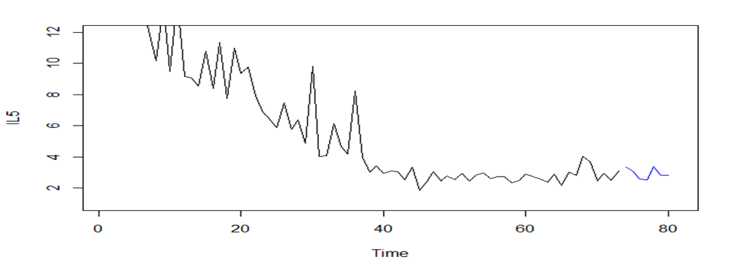
Multi variant Forecast – SHORT term 7 Days
US Daily Test Positive 7 days Forecast
IL Daily Test Positive 7 days Forecast
Ensemble
7.44, 8.14, 7.7, 7.73, 7.31, 7.24, 6.13
Ensemble
3.32, 3.07, 2.57, 2.54, 3.36, 2.8, 2.82

Slide 32
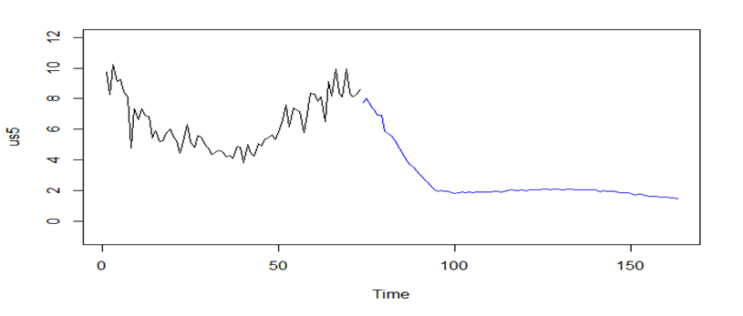

Multi variant Forecast – Long Term 3 Month
US Daily Test Positive 90 days Forecast
IL Daily Test Positive 90 days Forecast
Ensemble model
Ensemble model

Slide 33
Summary & Recommendations
In short term forecast, we see US test positive rate to start trending downwards, while Illinois stabilize around 5%
In long term forecast, us continue the downward trend for ~25 days, then stabilize around 5%. Illinois continue the 5% low rate.
We suggest to update the forecast on periodic basis, take in the new daily recorded data value for better understanding of the short and long term COVID19 behavior ahead of us.
THANK YOU!
For Questions or Comments:
ybennett@smu.edu

